Slide 1
Soul Retrieval from the Correllian Perspective: The Nine Mondads and Shadow Work [1]
[1] Information for this class is taken from the Witch School Third Degree Lessons in the Correllian Tradition by Rev. Donald Lewis-Highcorrell.

Slide 2
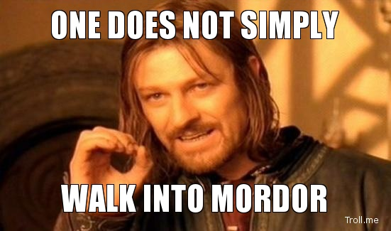

Slide 3
The Soul and Nine Monads

Slide 4
The basics:
What is Soul Retrieval for anyway?
  Deep Healing
  Reconnection to “lost” parts of our Soul
Not something that is done lightly but can benefit most everyone.
Soul Retrievals are only one step in a long process.
Not a one shot cure for what ails you. It can be necessary to do a repetitive process.

Slide 5
What is a Soul anyway?
From the Correllian perspective the Soul is part of the Higher Self.
The Soul is part of the being that, arising from the Monad, differentiates itself into a single stream of experience and persona, which it develops through multiple incarnations and multiple variations on incarnations.

Slide 6
What is a Monad?
In creating existence the Goddess first divided herself into Monads, of which there are nine.
Each of the Monads is a separate manifestation of Goddess encapsulating Her essence at that moment in creation.
All nine Monads possess the entire nature of Deity in microcosm but with variations depending upon their place in the sequence of creation.
Each Monad is composed of many, many Souls. Just as Monads are more differentiated than Goddess, so the Souls are more differentiated than the Monads.

Slide 7
Why should I care about Monads for a Soul Retrieval?
To understand the Monad your Soul is a piece of helps with Soul Retrievals because you understand the personality of your Soul and how it views the world around it.
This familiarity can help with the Soul’s healing.
As you learn about the Monads, see if you can recognize yours.
This will allow you to make a more emotional connection with the Monads, who are part of the Higher levels of our own beings, and of which we and our Souls are aspects.

Slide 8
What are the nine Monads?
Protoneira – The Perfectionist
  The 1st Monad, the 1st attempt by the Goddess to enter the world of matter
  All about structure, form and theory as the Goddess tried to make sense of the world of matter
  Protoneira Souls are very strong on ideas of how things should work but not so good on follow through.
  Protoneira Souls are often leaders in areas of morality, philosophy or law.
  They adhere strongly to ideals and principles and can be quite unforgiving of others who don’t.

Slide 9
What are the nine Monads? Continued
Deuteroneira – The Nurturer
  Because Protoneira became stuck in patterns of the physical the Goddess created the 2nd Monad
  Deuteroneira’s express purpose was to help Protoneira to move forward by analyzing Protoneira’s patterns and put them into active practice which Protoneira perceived as usurpation instead of assistance.
  Deuteroneira Souls are loyal, nurturing and protective in their relationships. They are strongly analytical and can be very practical but tend to defer to others.

Slide 10
What are the nine Monads? Continued
Tritoneira – The Performer
  When Protoneira rejected Deuteroneira’s help, Deity’s experience of the physical fell into an impasse so She created Tritoneira with the intention of spurring Protoneira into action.
  Tritoneira’s purpose was to put the abstract ideas of Protoneira and the practical applications of Deuteroneira into actual practice.
  Tritoneira is about practical application, growth and expansion.
  Tritoneira Souls are great communicators and are very persuasive.

Slide 11
What are the nine Monads? Continued
Tetroneira – The Romantic
  Where the first three Monads are all about understanding the physical and putting that into practice, Tetroneira was created to better understand the Monads and their manifestations.
  Tetroneira is all about emotional and interpersonal patterns. Tetroneira creates new patterns which add depth to experience.
  Tetroneiran Souls are highly emotional, creative and responsive. They make great artists. However, they can tend to be very self centered.

Slide 12
What are the nine Monads? Continued
Pemptoneira – The Thinker
  While Tetroneira gained personal insight to the patterns between the Monads, she lacked the distance to understand the patterns themselves.
  Pemptoneira sought to understand these patterns and gain facility in manipulating them.
  Curiosity is Pemptoneira’s primary characteristic and study its’ primary application
  Pemptoneiran Souls tend to be aloof and reserved and constantly revises its attachments as its understanding changes.

Slide 13
What are the nine Monads? Continued
Ektoneira – The Loyalist
  Ektoneira sees to put the understanding of relationships into practice.
  In creating Ektoneira, Diety combined the subjectivity of Tetroneira and the objectivity of Pemptoneira in an attempt to achieve balance.
  Ektoneira has definite expectations of her relationships and can become quite upset when they are not realized.
  Ektoneira is loving, nurturing and protective and is capable of great self sacrifice. She craves peace and harmony.
  Ektoneira’s protectiveness can become paranoia and she can smother the very things she loves and seeks to protect.

Slide 14
What are the nine Monads? Continued
Ebdomoneira – The Enthusiast
  Because Ektoneira ultimately failed to bring balance because of the dissonance between her expectations and reality, Deity created Ebdomoneira
  Ebdomoneira was created to appreciate the differences between things and to embrace individuality.
  Loyalty and devotion are Ebdomoneira’s greatest strengths and can be her greatest weakness. She lacks judgement and tends to accept things unconditionally.
  Consequently she can be oblivious to the good or bad effects of things, entranced by their individual characteristics instead of their outcomes.

Slide 15
What are the nine Monads? Continued
Ogdoneira – The Leader
  Ogdoneira is all about order, process and focus. She is pragmatic and goal oriented. She seeks to impose order on her environment.
  Ogdoneira loves communication and interaction. She is a trailblazer who loves new situations and information.
  The Ogdoneiran Soul enjoys conflict for it’s own sake, viewing competition as a productive way to find answers. They can seem heavy-handed and controlling.

Slide 16
What are the nine Monads? Continued
Enatoneira – The Peace-Maker
  The final Monad, created because the fact that conflict may cause damage was lost on Ogdoneira.
  A builder and organizer Enatoneira seeks to impose order like Ogdoneira but in a more diplomatic way.
  Enatoneira is innovative and adaptable. She is a peacemaker and resolver of oppositions. She can rise above the patterns which she works with.
  The Enatoneiran Soul seeks to transcend limiting situations.

Slide 17
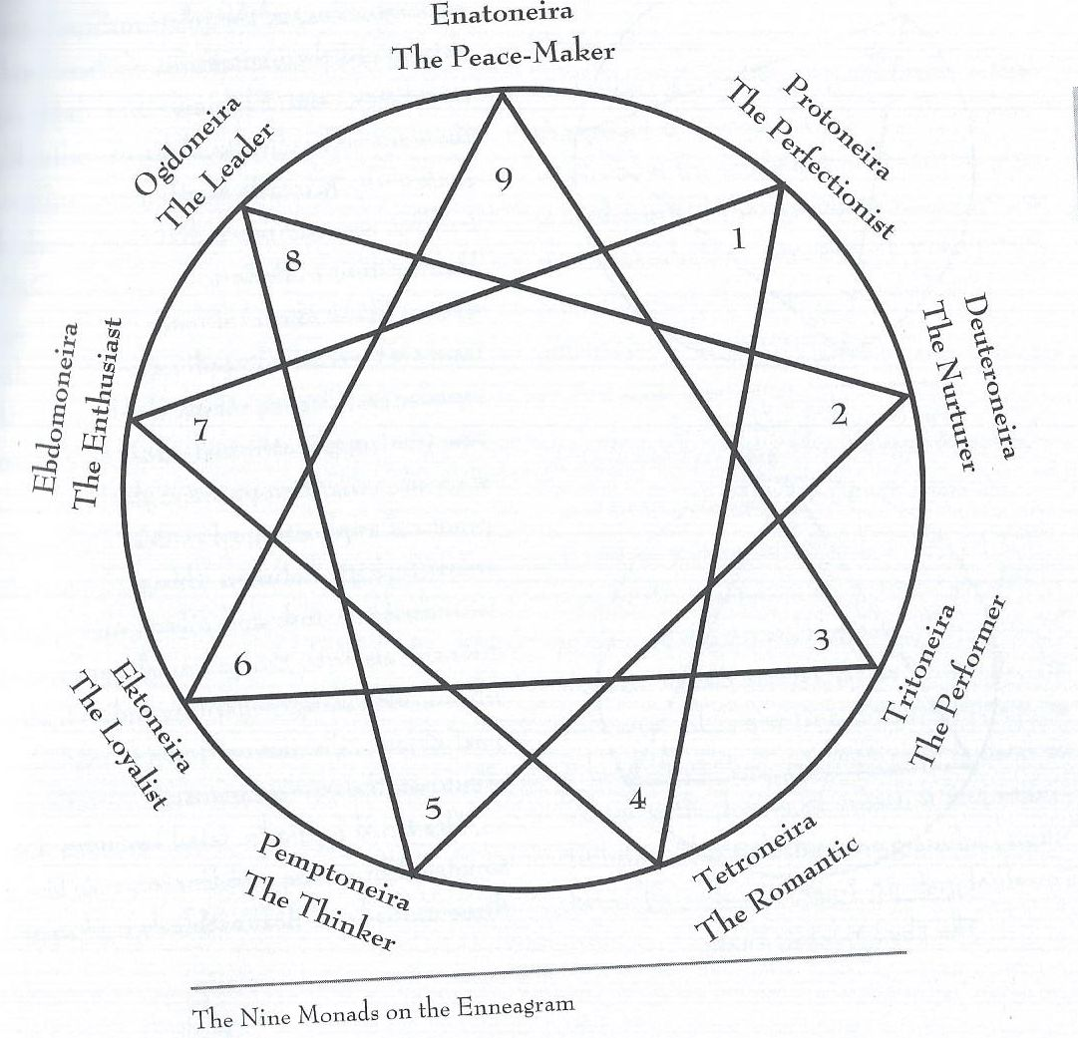

Slide 18
Recap of the Nine Monads:
The first three Monads focus on understanding the physical world:
  Protoneira - “To Conceive”: To gain abstract understanding of Being; to find the “right way” for things to be.
  Deuteroneira – “To Nurture”: To develop practical systems for dealing with Being; to nurture and assist in pragmatic ways.
  Tritoneira – “To Pursue”: To implement systems of dealing with Being; to put things into motion and expand them

Slide 19
Recap of the Nine Monads:Continued
The second three Monads focus on relationships between things in the world:
  Tetroneira – “To Develop”: To gain abstract understanding of relationships between things; to be creative and invent new ways of doing things.
  Pemptoneira – “To Study”: To develop practical systems for dealing with relationships between things; to understand and manipulate cause and effect.
  Ektoneira – “To Admire”: To implement systems for dealing with relationships between things; to gain practical facility with building and maintaining relationships.

Slide 20
Recap of the Nine Monads:Continued
The final three Monads focus on individuality:
  Ebdomoneira – “To Apply”: To gain abstract understanding of the role of individuality vs. the whole; to appreciate individuality in creation.
  Ogdoneira – “To Establish”: To develop practical systems for dealing with the role of individuality vs. the whole; to impose order on creation.
  Entoneira – “To Resolve”: To implement systems for dealing with the role of individuality vs. the whole; to resolve conflicts and create new forms to allow systems of order to move forward in creation.

Slide 21
Shadow Work:
Identifying what needs to be healed by the Soul Retrieval

Slide 22

What is Shadow Work and why do we need to do it?
Published on Mar 14, 2014, Rev. Don discusses the importance of the Shadow and of Shadow Work
  https://www.youtube.com/watch?v=JKDaxFcFVyY
  Or double click on the black box!

Slide 23
How to identify that which must be healed.
The next step of the Soul Retrieval process is to determine WHAT you need to heal.
  Blockages:
    Exaggerated aggravation with issues
    Outmoded belief systems
    Behavioral pattern
  Wounds:
    Traumatic experiences in the current or previous life cycles
    Negative emotions

Slide 24
How to identify that which must be healed. Continued
This part of the process is the longest and most difficult
Done through a process called Shadow Work, many sessions of self examination and meditation.
Peel back the layers of the onion until you find no more layers hiding the truth
Keep a journal after each meditation to identify themes and patterns. Also allows you to go back and re-examine topics of prior meditations.
This is the step of the process where understanding the Monad of your Soul helps with the identification of the root cause needing healing.

Slide 25
How to identify that which must be healed. Continued
This is a reiterative process. The more complex the wound to the Soul the longer it will take.
Done properly, this will lead to a Soul Retrieval that is euphoric and full of positive emotions
Rushed through or done improperly, this will lead to a Soul Retrieval that can be very messy and emotionally draining.

